Slide 1
CCBE CONFERENCE:
TRAINING OF LAWYERS, CHALLENGES AND OPPORTUNITIES
WORKSHOP 3
HELP IN THE EU
WIFI L42
Pass: allfornet

Slide 2
WORKSHOP 3
Eva Pastrana, Head of HELP
Josquin Legrand, representative of Conseil national des barreaux (CNB)
Lenka Vojířová, representative of the Czech Bar Association, international relation department
Diego Rafael León Burgos Legal Advisor at Consejo General de la Abogacía Española

Slide 3
HELP IN THE EU
EVA PASTRANA

Slide 4
HELP IN THE EU
JOSQUIN LEGRAND

Slide 5
HELP IN THE EU
LENKA VOJÍŘOVÁ

Slide 6
Training Conference Brussels 14.12. 2017
Czech and Slovak Joint Multilateral Course
Lenka Vojířová
Czech Bar Association
vojirova@cak.cz

Slide 7

HELP – Human Rights Education for Legal Professionals
HELP in the 28 (Jiří Novák – Czech InfoPoint and National Tutor, Michaela Chladeková – Slovak InfoPoint)
Course on Data protection and Privacy Rights
Current topic (GDPR etc.)

Slide 8
Joint Multi-country Czech and Slovak Course
Why we decided to organize the joint multi-country Czech/and/Slovak Course?
Number of participants
Same language
National tutor
Necessity and advantage of distance e-learning way – our national tutor and his perception of distance tutoring ☺…next slide…

Slide 9
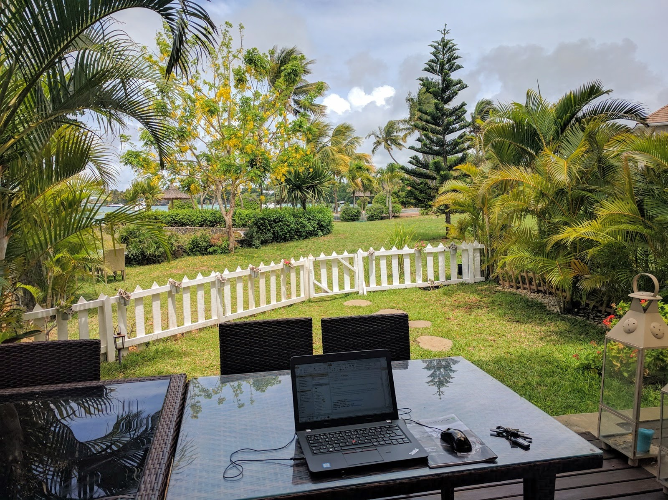

Slide 10
Getting ready for the Course
13th December 2016 - Course approved by the Czech Bar Ass. and a week before by the Slovak Bar Ass.
Timing! (End of the EU funded programme – 31st March 2017)
Service providers (Translation, Interpretation for the Kick Off, Venue of the Kick Off – Public Deffender Office, Coffee Breaks/Lunch)
Setting the date of the Kick off meeting - 13. January 2017 and informing participants
The cooperation with HELP secretariat was great and smooth!

Slide 11
Kick off meeting – 13th January 2017
Brno (half way from Prague and Bratislava)
Attendance of almost all participants – participants user accounts created
Welcoming words from representatives of the Czech and Slovak Bar
Presentations from Eva Pastrana, Head of HELP
Presentations of the National Tutor and Slovak expert linked with the topic on Data Protection and privacy rights
Information on the „special award“ for 2 best participants

Slide 12
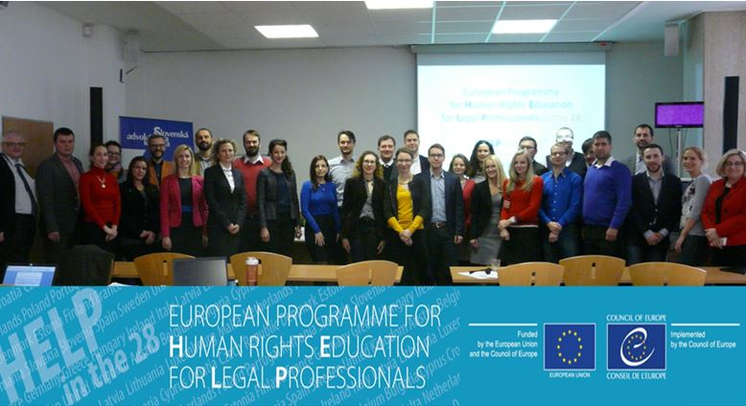
A Photo of participants at Kick off meeting

Slide 13
Course on Data protection and Privacy Rights
Course in the Czech language uploaded 16th January 2017
10 Modules (Mandatory/Optional)
Participants studied 3 hours a week
Discussing Forum at CoE HELP course websites
Uploading study materials by the National Tutor

Slide 14
Course on Data protection and Privacy Rights
Final test (before March 13th 2017; March 31st 2017 at the latest)
(20 multiple-choice questions; at least 40 % must be answered correctly for awarding the certificate)
Final test passed by 25 participants (out of 30) – 5 participants did not take the test
Two best participants – a study trip to Strassbourg

Slide 15
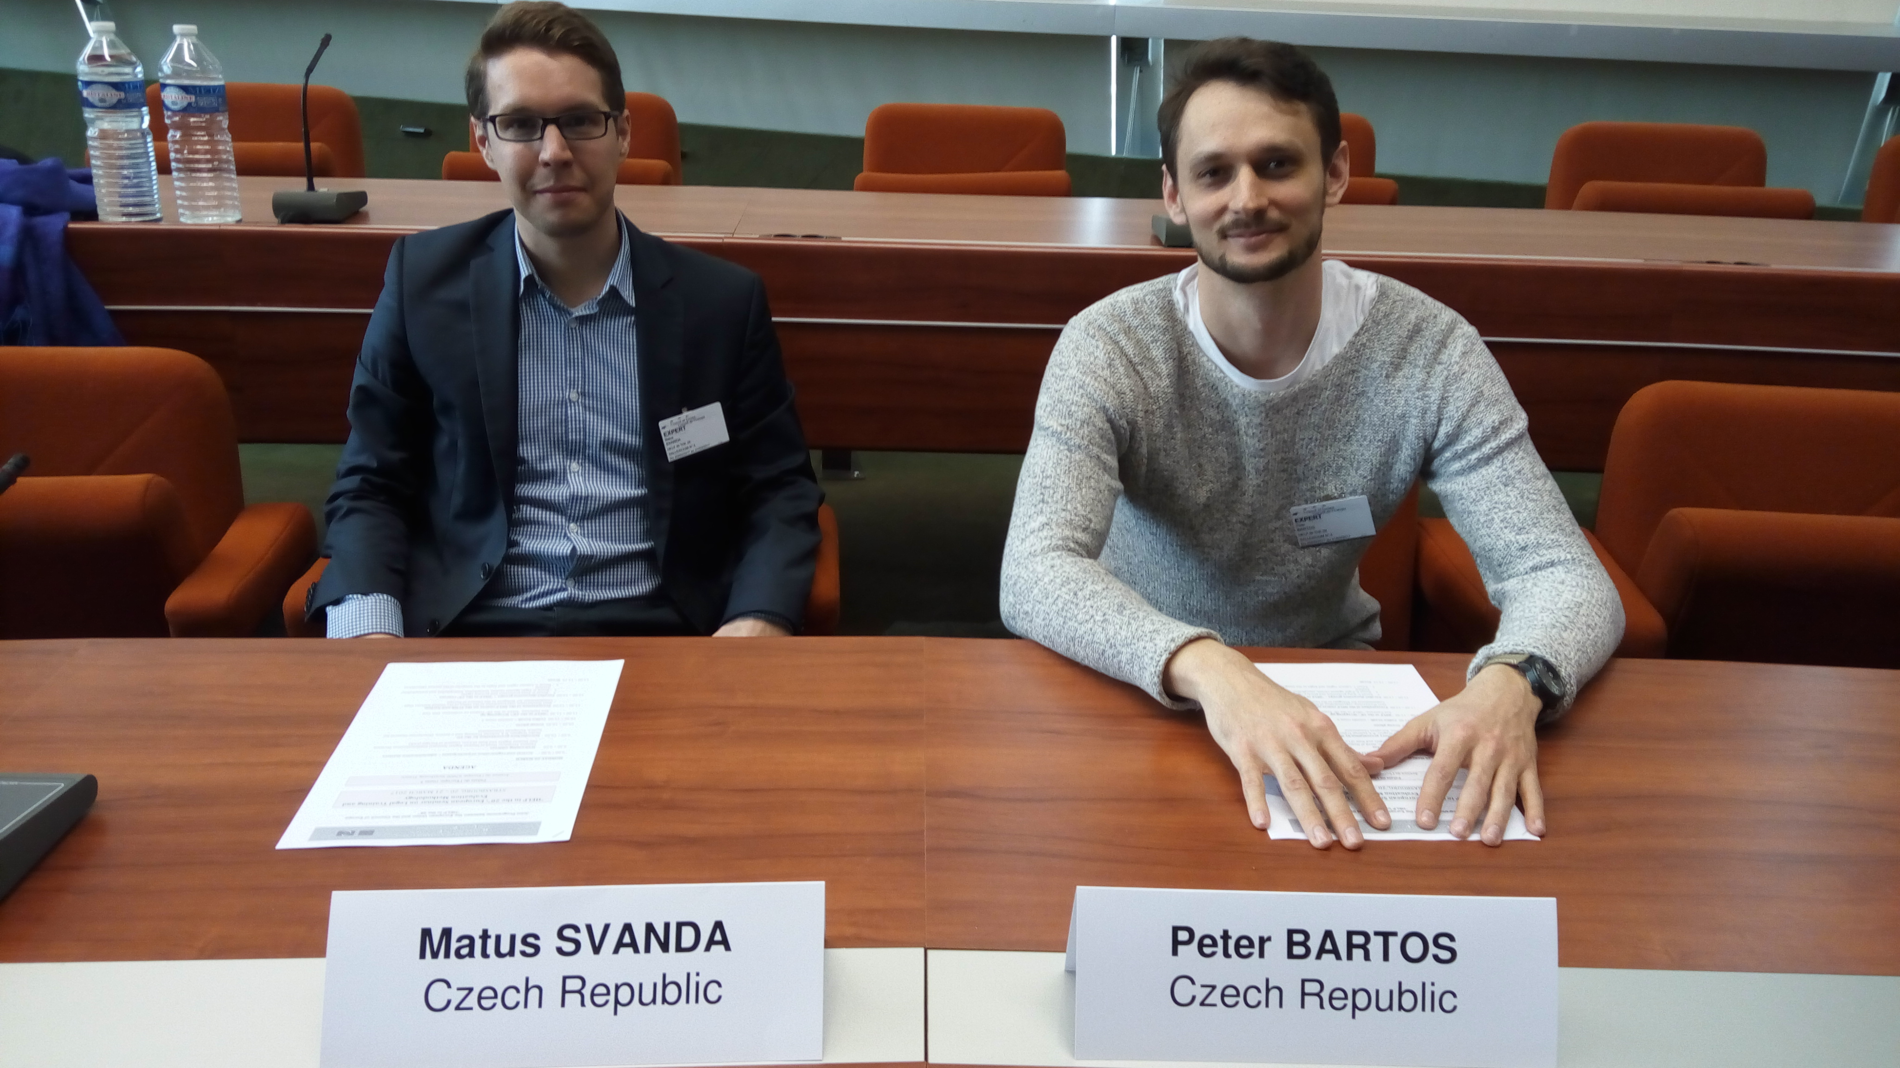

Slide 16
Handing over certificates
Separately with the Czech and Slovak Bar Association (May 2017)
Presence of national tutor and representatives of the Bars
Positive feedback from participants

Slide 17
Comming to a close…
Recommendation of any course in the HELP programme
Excellent work of HELP secretariat
Great cooperation with Slovak Bar
The Czech Bar promised and will repeat the course on Data protection and Privacy Rights

Slide 18
Thank you for your attention.
Mgr. Lenka Vojířová
Czech Bar Association
Národní 16
Prague
vojirova@cak.cz

Slide 19
HELP IN THE EU
DIEGO RAFAEL LEÓN BURGOS

Slide 20
HELP IN THE EU
EVA PASTRANA

Slide 21

European Programme for
Human Rights Education for Legal Professionals
“HELP”
Eva Pastrana

Slide 22


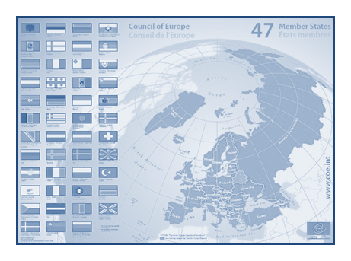

Overview
What is HELP?
HELP courses (VAW and DV)
Geographical outreach
Future EU-HELP partnership

Slide 23

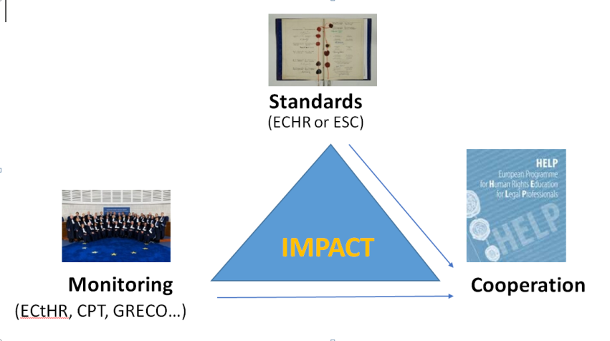

Slide 24

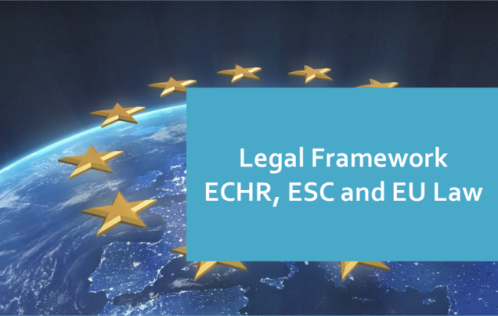
HELP’s goal
HELP judges, prosecutors and lawyers to apply European human rights standards in their daily work, mainly by training
Notes:
ECHR + ESC + CoE legislation + EU law for EU
+ EU Charter and EU law for EU countries

Slide 25

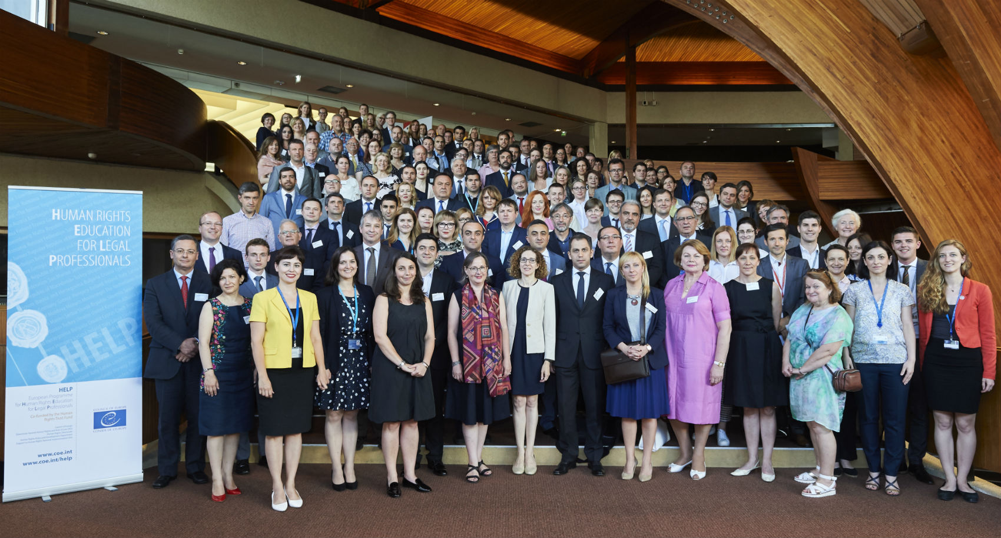
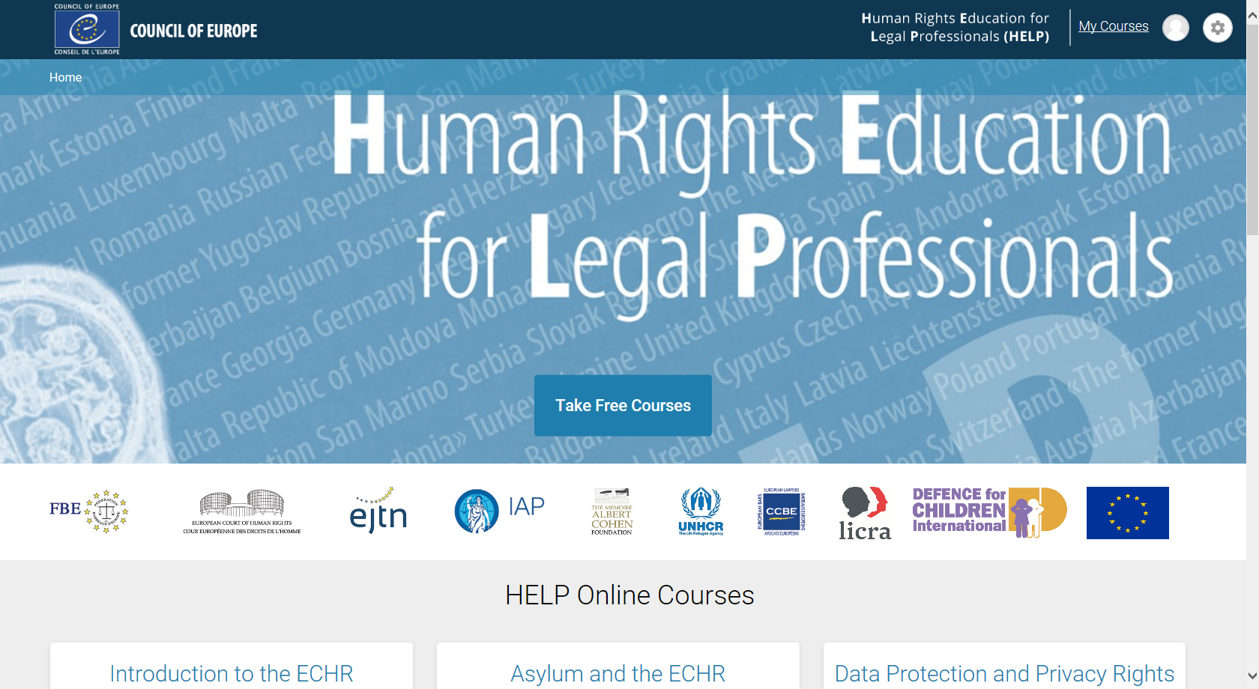
HELP key components
1) HELP Network
2) Free online courses

Slide 26


HELP course examples
Click on the pictures to watch presentation videos

Slide 27
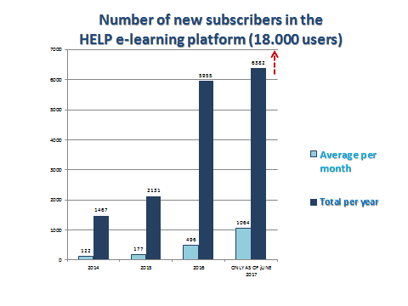
Notes:
Number of new subscribers in the HELP e-learning Platform
Average per month Total per year
2014 122 1467
2015 177 2131
2016 496 5955
ONLY AS OF jUNE 2017 1064 6382

Slide 28
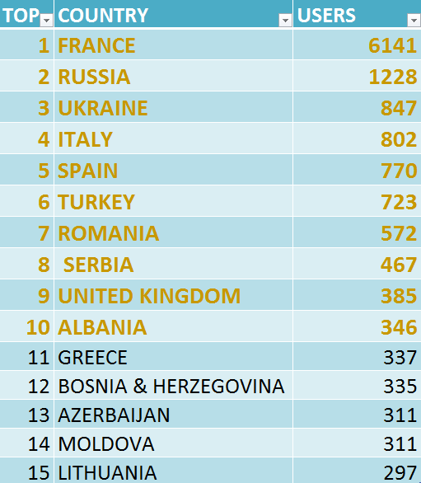
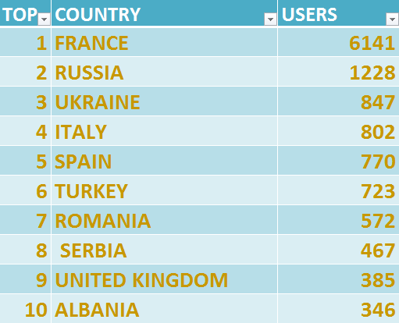
Top regions & countries
HELP in EU: 11.700
HELP in WB and TK: 2.070
HELP in Russia: 1.220
Eastern Partnership: 1.880

Slide 29
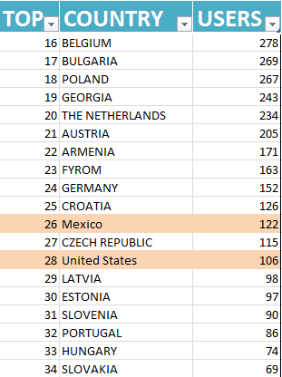
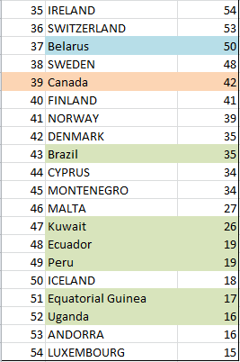

Slide 30









HELP courses
Admissibility criteria (ECtHR)
Notes:
FARXHT: 205
Antidiscrimination: 207
Hate crime/hate speech: 164
TOTAL:
TOTAL HELP28: 1.765 (995 + 770 Asylum)
The promotion by the Spanish School of Judiciary of the HELP course on introduction to the Convention and Strasbourg (optional so far) has led to the decision to make it compulsory for new entry judges in Spain as of 2018.
In France, the participants of the HELP course on data protection and privacy rights (DPPR) set up an organisation that collectively submitted a proposal to improve the new DPPR law to the French data protection authority.
The Lithuanian labour inspectorate received a request from the Norway labour inspectorate to cooperate in joint (cross-border) inspections both in Lithuania and in Norway for “fake posting” and “social dumping”. He said, “The knowledge that I gained during the HELP course helped me to successfully perform in joint inspections, achieve results and, hopefully, accelerate future cooperation of the Lithuanian and Norwegian labour inspectorates.”

Slide 31

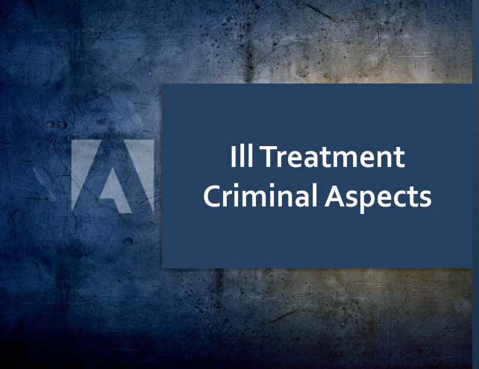



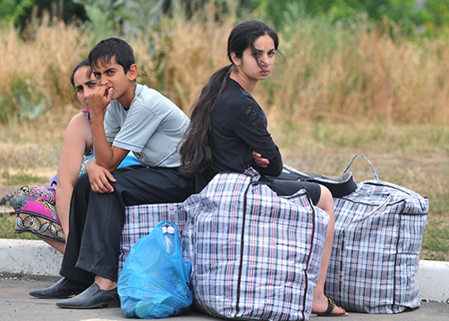
HELP online courses

Slide 32

HELP course on Violence against women (VAW) and domestic violence (DV)
VAW: violation of HR and discrimination against women.
Many forms: physical, sexual, stalking, FGM or forced marriages.
  Structure:
  Understanding VAW and DV
  Int’l and European Legal Framework
  Overcoming barriers to Justice / A2J
  Criminal Justice Response
  Civil Justice Response
  Alternative Dispute Resolution
Joint collaboration between the Equality and Human Dignity Department, Violence Against Women Division and HELP Programme of the Council of Europe
Notes:
Many forms: physical violence, sexual abuse, stalking, female genital mutilation or forced marriages.
The course consists of the following seven substantive modules:
❖ Understanding violence against women and domestic violence
❖ International and European Legal Framework
❖ Overcoming barriers / access to Justice
❖ Criminal Justice Response I – Investigation and pre-trial
❖ Criminal Justice Response II – Trial and sentencing
❖ Civil Justice Response
❖ Alternative Dispute Resolution

Slide 33
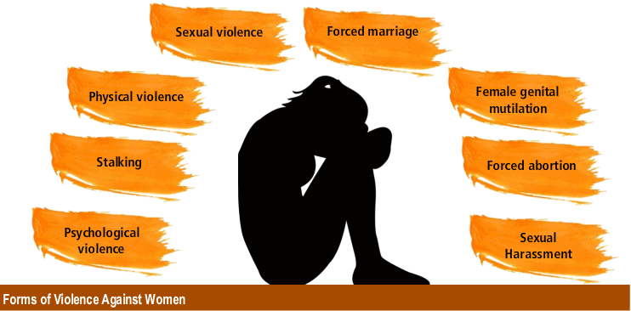
HELP course on Violence against women (VAW) and domestic violence (DV)
VAW: violation of HR and discrimination against women.
Joint collaboration between the Equality and Human Dignity Department, Violence Against Women Division and HELP Programme of the Council of Europe
Notes:
To ensure that fundamental rights are respected it is important to also consider the different forms of VAW. Click on each of the different manifestations of VAW covered by the CoE’s Instanbul Convention.
Many forms: physical violence, sexual abuse, stalking, female genital mutilation or forced marriages.

Slide 34

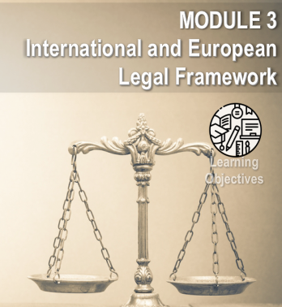
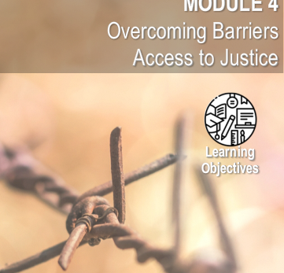
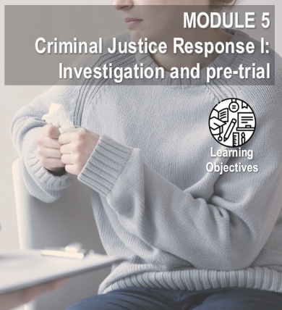


HELP course on Violence against women (VAW) and domestic violence (DV)
  Understanding VAW and DV
  Int’l and European Legal Framework
  Overcoming barriers to Justice / A2J
  Criminal Justice Response
  Civil Justice Response
  Alternative Dispute Resolution
Notes:
Many forms: physical violence, sexual abuse, stalking, female genital mutilation or forced marriages.

Slide 35

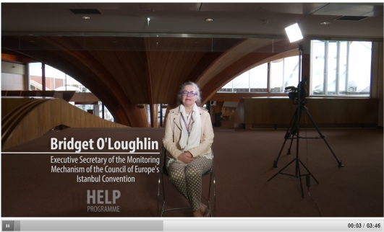

Course on VAW and DV
Click on the picture to watch the course
presentation!
Notes:
Bridget O’Loughlin – Executive Secretary of the Monitoring Mechanism of the Council of Europe’s Instanbul Convention

Slide 36

  Course VAW and DV OBJECTIVES
  Knowledge
    European legal system of protection
    Case law (ECtHR, CJEU)
  Skills & attitudes: applicable in your daily work
Notes:
Skills & attitudes: Refer to relevant legal framework in your daily work as legal professional

Slide 37

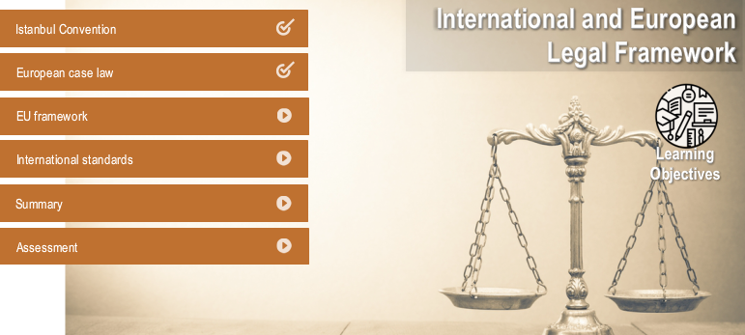
Notes:
Skills & attitudes: Refer to relevant legal framework in your daily work as legal professional

Slide 38
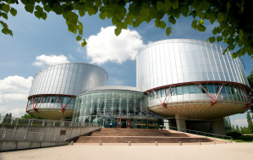
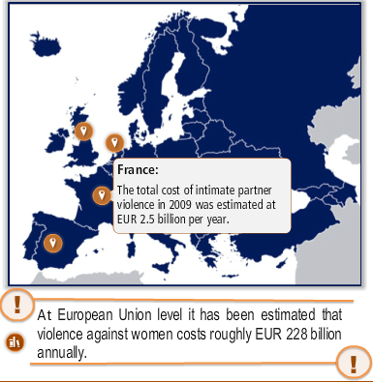
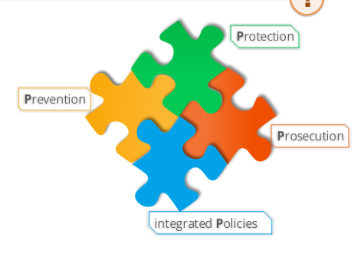
Notes:
Skills & attitudes: Refer to relevant legal framework in your daily work as legal professional

Slide 39
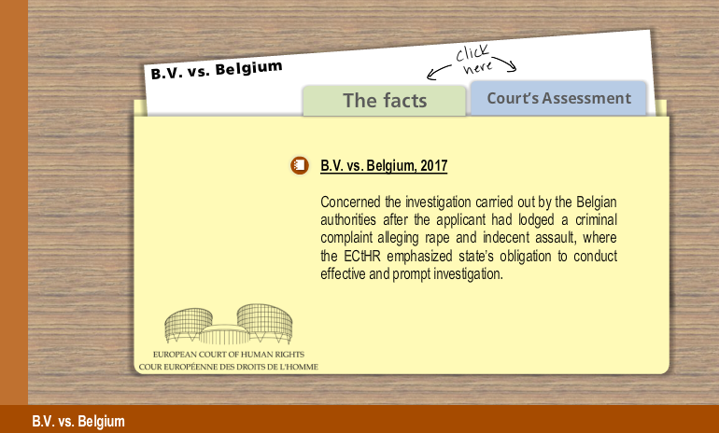
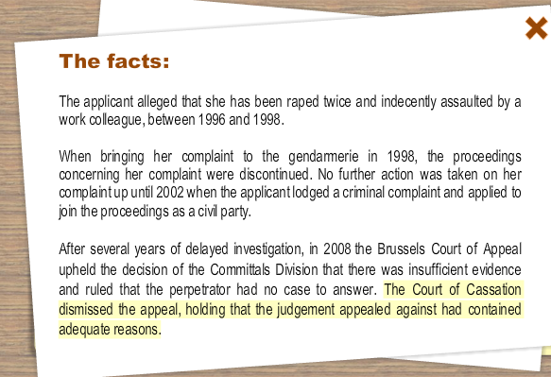
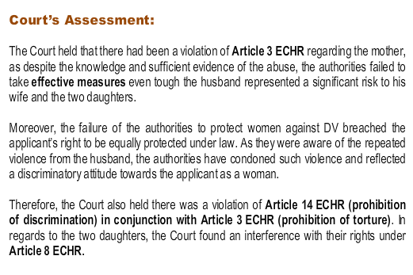
Course ‘VAW and DV - case law examples’

Slide 40
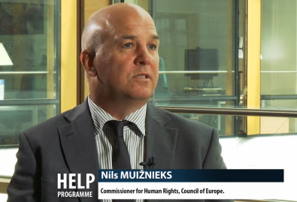
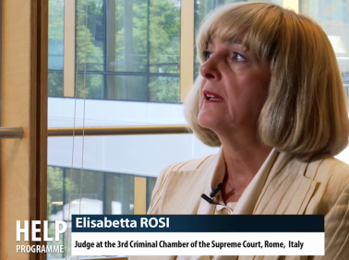
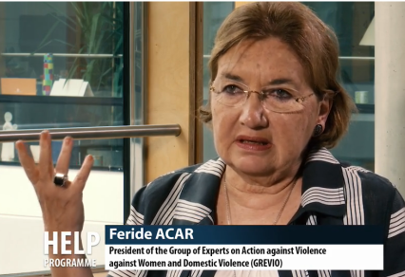
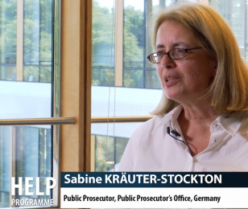
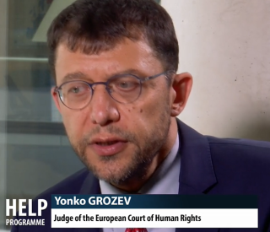
Course “VAW and DV” videos
Notes:
In this video, CoE’s Commissioner on Human Rights coments on how VAW is spread in European countries and how damaging gender stereotypes are.
Interview with Feride Acar, President of the Group of Experts on Action against VAW and DV (Grevio).

Slide 41
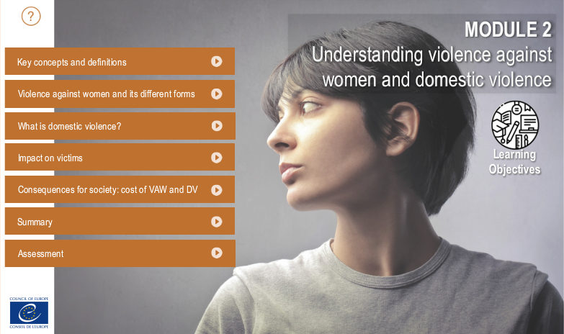
Course ‘‘VAW and DV – Module example’’
Notes:
This module is designed to enhance reader’s understanding and knowledge of Violence against Women (VAW) and Domestic Violence (DV).
Professionals should manage to reflect on their own perceptions of VAW, comprehend how violence is experienced by the victims and how it impacts their lives, as well as to familiarise themselves with specific terminology.

Slide 42
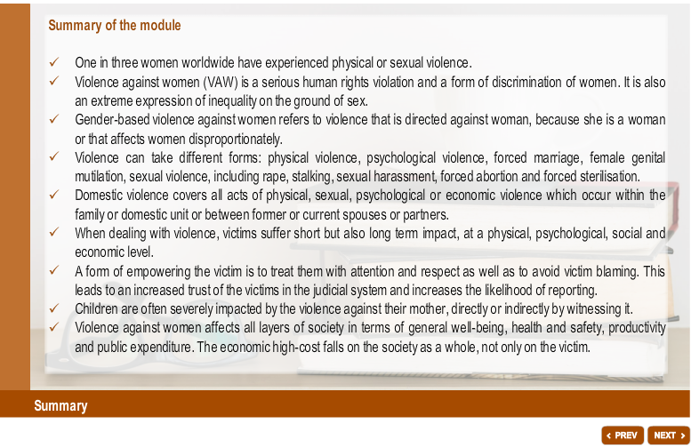
Course on VAW and DV – Summary of module
Notes:
Bridget O’Loughlin – Executive Secretary of the Monitoring Mechanism of the Council of Europe’s Instanbul Convention

Slide 43
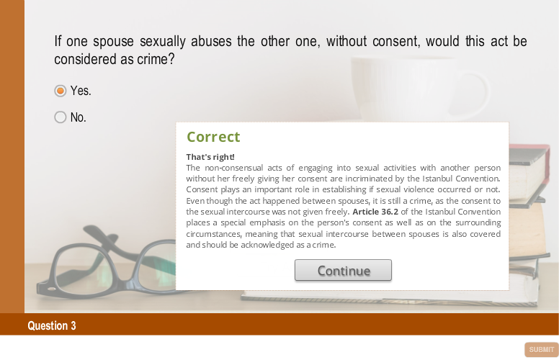
Course on VAW and DV – Assessment

Slide 44
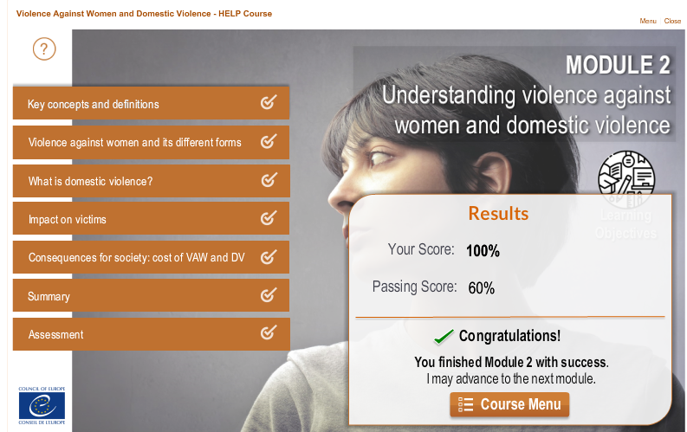

Slide 45
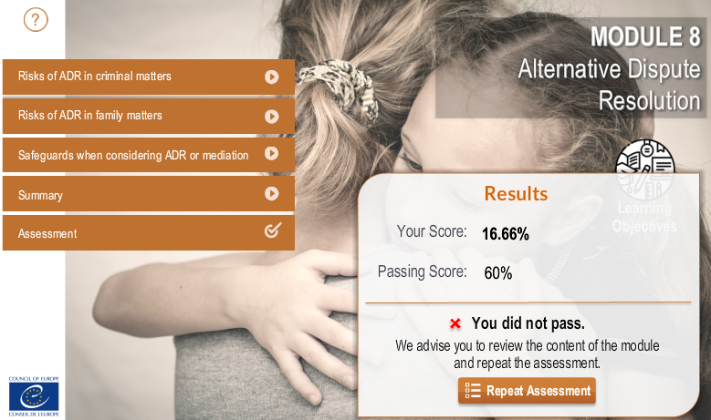

Slide 46

Course ‘‘VAW and DV’’
Online course duration is 10-12 hrs. More if reviewing links
Moderated course by national tutor: 3 hrs per 2 weeks over 2-3 months

Slide 47

Courses available
Introduction to the ECHR and the ECtHR
Admissibility criteria (ECtHR)
Asylum
Family law
Child-friendly justice and children’s rights
Anti-discrimination
Hate crime/hate speech
Community sanctions and alternative measures to detention
International co-operation in criminal matters
Business and human rights
Counterfeiting of medical products and crimes against public health
Transitional justice
Property rights
Freedom or expression
Trafficking in light of the ECHR
Pre-trial investigation in the light of ECHR
Reasoning of judgments
Fight against racism, xenophobia and homophobia
Data protection and privacy rights
Labour rights
Right to the integrity of the person (bioethics)
‘HELP in the 28’ courses

Slide 48
HELP pipeline courses for 2018
Child refugee and migrants
Procedural rights in criminal proceedings and victims’ rights
Radicalisation Prevention
Family Law
Rights of persons with disabilities
Human Rights in Sports
Fight against Drugs
EU funding
Notes:
This is to send you the list of the HELP courses, with yellow highlights those that may have topics or modules relevant for police in the context of counter-terrorist operations:
1. Introduction to the ECHR and the ECtHR
2. Admissibility criteria (ECtHR)
3. Asylum
4. Family law
5. Child-friendly justice and children’s rights
6. Anti-discrimination
7. Hate crime/hate speech
8. Community sanctions and alternative measures to detention
9. International co-operation in criminal matters
10. Business and human rights
11. Counterfeiting of medical products and crimes against public health
12. Transitional justice
13. Property rights
14. Trafficking of human beings
15. Pre-trial investigation in the light of ECHR
16. Reasoning of judgments in criminal cases
17. Fight against racism, xenophobia and homophobia*
18. Data protection and privacy rights*
19. Labour rights*
20. Right to the integrity of the person (bioethics)*

Slide 49
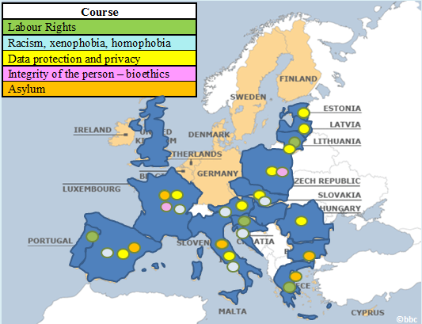
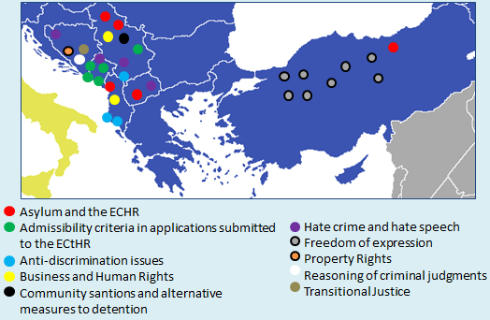
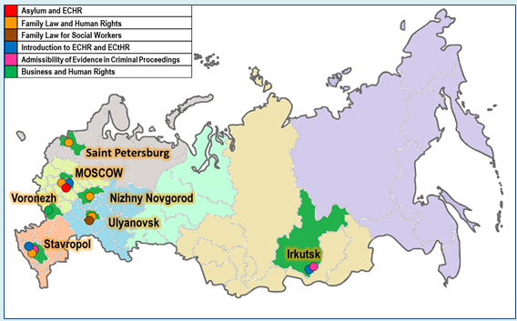
CoE HELP’s geographical outreach – 830 million Europeans

Slide 50
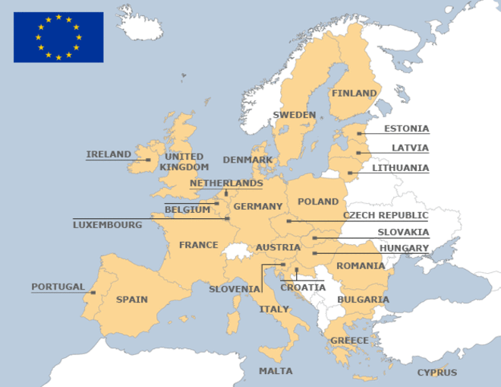
HELP in the EU
HELP in the 28 –I
Austria
Bulgaria
Croatia
Czech R.
Estonia
France
Greece
Italy
Latvia
Lithuania
Poland
Portugal
Romania
Slovakia
Slovenia
Spain
Not yet
Belgium
Cyprus
Denmark
Finland
Germany
Ireland
Luxembourg
Malta
Netherlands
Sweden
©bbc

Slide 51
Direct beneficiaries of “HELP in the 28" tutored courses
Notes:
In France, the participants of the HELP course on data protection and privacy rights (DPPR) set up an organisation that collectively submitted a proposal to improve the new DPPR law to the French data protection authority.
The Lithuanian labour inspectorate received a request from the Norway labour inspectorate to cooperate in joint (cross-border) inspections both in Lithuania and in Norway for “fake posting” and “social dumping”. He said, “The knowledge that I gained during the HELP course helped me to successfully perform in joint inspections, achieve results and, hopefully, accelerate future cooperation of the Lithuanian and Norwegian labour inspectorates.”
For the first time in Greece, a State legal aid service has been set up in 2017 to assist asylum seekers at the appeals level. There was a nationwide call for legal experts and 10 lawyers were shortlisted; 9 out of those had successfully completed the Help program on asylum. No more HELP-certified lawyers applied. So all, the 9 who applied got it.

Slide 52
HELP in the EU (CoE, CGPJ, CGAE, NIM)
New HELP courses /modules:
  family law
  procedural rights in criminal proceedings and victims’ rights
  gathering and use of evidence in terrorism cases
New 15 national adaptations for EU MS
8 Cross-border courses piloted covering 20 (new & existing) courses
Training of Trainers (ToT)
Target:
  560 EU legal professionals
  20 EU trained trainers

Slide 53
HELP Radicalisation Prevention
New HELP course and 4 nat’l adaptations
  Basic module(s) (for all) for consistency and cross-profession
  Specific modules for
    Prisons and probation staff
    prosecutors and judges (prison oversight ones)
2 Cross-border courses for 3 EU MS each (for 180)
3 European Seminars (for 180):
  exchanges on risk assessment tools
  implementation of de-radicalisation actions
  best practices - counselling and dev’t of counter narratives
ToT for 12
Notes:
Objectives
- General: To improve the criminal justice response in the EU to prevent radicalisation leading to terrorism and violent extremism
- Specific: To increase capacities and mutual trust of primarily justice practitioners dealing with radicalisation prevention (RP) through training, inter-agency and cross-border cooperation
Activities
- Training, Capacity buiding, Mutual learning, Best practices, Multi-disciplinary network
Type and number of persons benefiting from the project
180 participants benefiting from training and 180 from European Seminars:
- prison and probation staff
- prosecutors and judges
- (limited number of) police
Indirectly: religious representatives, social workers and counsellors, and platform users
National Training Institutions (NTI) from key EU MS of HELP Network
Expected results
Development of new (e-learning) HELP course and national versions on RP
Improved knowledge and skills of EU criminal justice practitioners on RP
Enhanced NTI capacities in targeted EU MS through training-of-trainers on HELP methodology and course on RP
Strengthened HELP Network in EU MS and promoted exchanges, networking, cross-border cooperation and mutual trust among EU justice practitioners on RP
Type and number of outputs
- HELP course on Criminal justice response to prevent radicalisation and national adaptations to at least 4 legal orders and languages among EU MS most affected by radicalisation/terrorism (i.e. AT, BE, DE, ES, FR, IR, NT).
- 2 cross-border kick-off for 60 each out of 180 participants who will continue e-learning courses moderated by national tutors
The course will have common and distinctive modules suited for different audiences:
o Basic module(s) (for all) for consistency and multi-agency approach
o Specific modules for different justice actors
- 1 Training-of-trainers on HELP methodology and course on RP
- 3 European Seminars for mutual learning, exchange of good practices and cooperation for an average of 60 persons each:
Before creating HELP course, to exchange information on risk assessment tools
Implementation of de-radicalisation programmes
Final conference to exchange best practices, and focus on counselling and development of counter narratives
Outputs will be disseminated through the HELP Network, e-learning platform, website and social media.

Slide 54
HELP in the Western Balkans and Turkey
©bbc

Slide 55
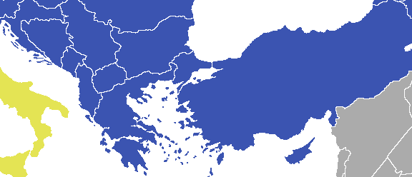
HELP courses in the Western Balkans and Turkey
Asylum and the ECHR
Admissibility criteria in applications submitted
to the ECtHR
Anti-discrimination issues
Business and Human Rights
Community santions and alternative
measures to detention
Hate crime and hate speech
Freedom of expression
Property Rights
Reasoning of criminal judgments
Transitional Justice

Slide 56
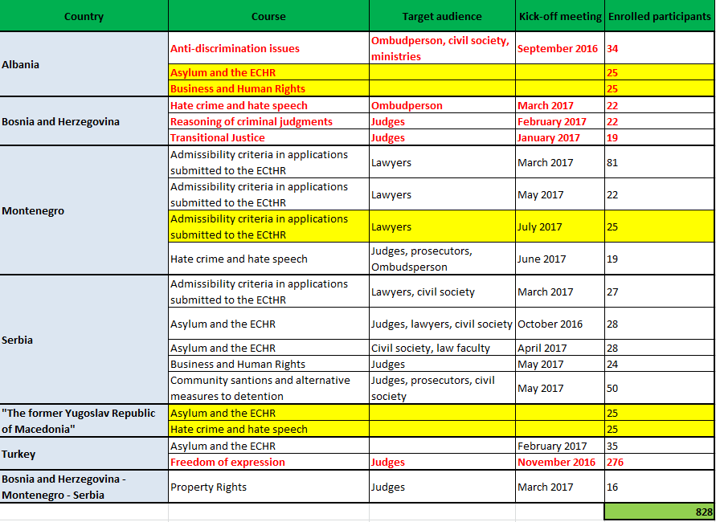

Slide 57
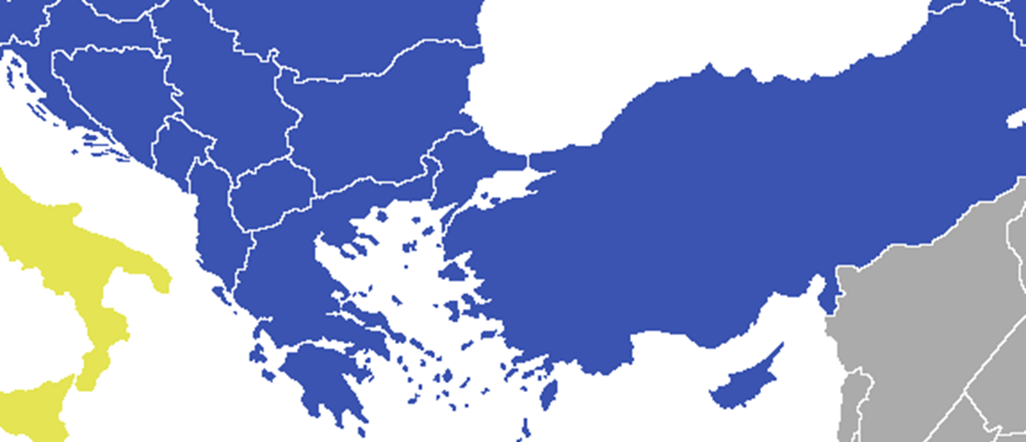
HELP ToTs in the Western Balkans and Turkey
In the framework of HELP in the Western Balkans and Turkey
In the framework of other CoE projects

Slide 58
HELP in the Western Balkans and Turkey
(II phase)
New HELP e-learning course on execution of judgments
Implementation of multi-professional / cross-border HELP courses, inter alia:
  Asylum and the ECHR
  Child-friendly justice
  Property rights
HELP Training-of-Trainers sessions
Extention of HELP methodology and courses to universities and civil society

Slide 59
HELP in the
Russian Federation
©bbc

Slide 60
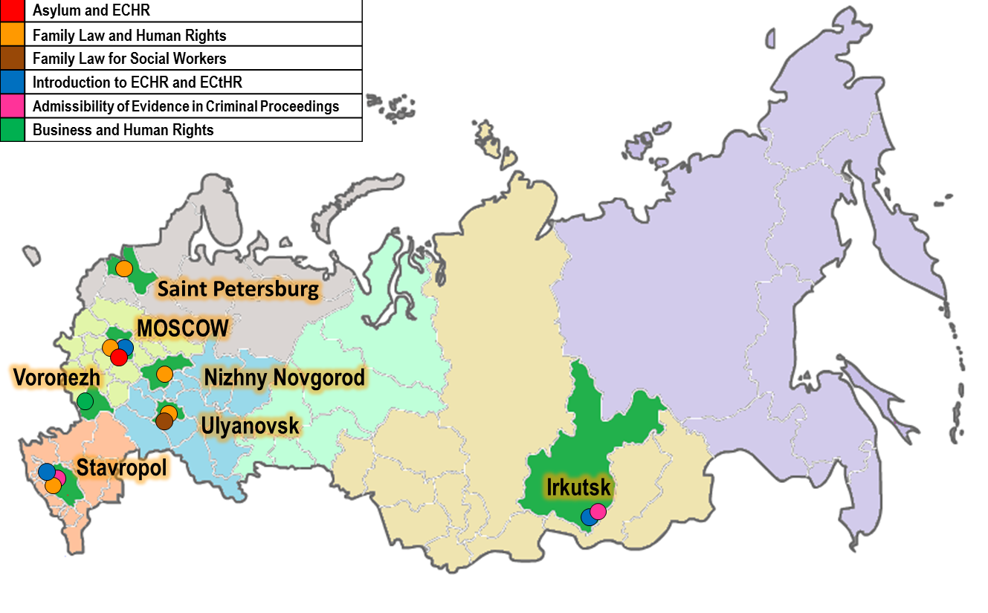
HELP in the Russian Federation

Slide 62
HELP in the Russian Federation:
Summary for 2015-2017
3 ToT and 1 HELP Trainers Conference
17 HELP Courses carried out by HELP trainers
907 participants (legal professionals, law students, civil servants)
2 Courses developed specifically for Russian judges:
  Admissibility of evidence in criminal proceeding
  Reasonable time in criminal proceedings

Slide 63
HELP training methodology –Timeline
Activity |  | Period (Months)
Training Needs Assessment (TNA) – identification of priority topics Selection of experts/consultants
Curriculum development of model course (English) | I WG meeting | 1-2
 | II WG meeting | 3-4
 | III WG meeting | 5
Development of articulate version (English) | Storyboard meeting | 6
Translation into national language |  | 7-8
Adaptation to national legal order (by HELP trainer) |  | 8-9
Implementation of the course and validation at national level | Selection of participants | 9
 | Launch (face-to-face event) | 10
 | Implementation | 10-14
 | Certification/Evaluation | 15
Model course (usually in English)
National version (translation of model course + complementing info for national legal context and practice
Notes:
Training Needs Assessment (TNA) – identification of priority topics by the Network (on the basis of the recent case law of Strasbourg (and Luxembourg) Court(s) in HR
Selection of experts/consultants
Curriculum development
(drafting learning objectives, detailed outline of the course, case studies, practical assignments, assessment tools, list of additional materials and references)

Slide 64
HELP trainer main functions
1. Proofreading
Review the translation of HELP course (provided by HELP/NTI/BA/University).
2. Development of the national adaptation
Adapt the model curriculum of the HELP course to the national legal order and needs of targeted legal professionals/law students.
3. (Usually) participate in the kick-off of the course
4. Moderate the course in the HELP e-learning platform. This includes enrolling participants, online moderation over 3 months, and evaluating results.

Slide 65
Future strategic CCBE-HELP-EU relation
Objective: better protection of human rights in Europe – promoting CoE HELP courses
Current projects with EU funding:
    HELP in the EU
    HELP radicalisation prevention
  Other donors projects: HELP in Russia, HELP in WB and Turkey
  Expanding coverage in CoE MS and beyond (Mediterranean)
  Increased cooperation with Universities
Call for CBBE’s support of a more strategic EU-HELP relationship for more impact in EU… and beyond.
Notes:
Since HELP works and its courses are in increasing demand everywhere, I would finalise by calling for your support to promote this online course back home, in your countries and, help us push the European Commission to back more resources for human rights training in Europe.
With funding of the EU, we are implementing two HELP projects for the EU, one of them on Radicalisation Prevention.
But, in the long term, we need to do more to jointly face the extraordinary number of human rights challenges, from growing populist nationalism, rising xenophobia or social injustice. Compared with the EU, the CoE’s budget for 2017 would represent less than 0.3% of the EU’s general budget.
That is why, to make full use of HELP courses like the one I just presented, we need a more strategic EU-HELP relation if we want larger impact to protect human rights across the European continent.

Slide 66
HELP
Good training for good judgments
Thank you very much for your attention!
HELP Head of Unit: Eva.PASTRANA@coe.int
HELP in Russia: Anastasia.SHADAROVA@coe.int
HELP in Western Balkans: Valentina.BOZ@coe.int
HELP in EU - Universities: Ana.MEDARSKA-LAZOVA@coe.int
EU-CoE HELP Radicalisation Prevention: Ana-Maria.TELBIS@coe.int

Slide 67
European Programme for
Human Rights Education for Legal Professionals
“HELP”
Course on Data Protection and Privacy Rights
Eva Pastrana

Slide 68


Overview
What is HELP?
HELP courses
  Data Protection and Privacy Rights
  International Cooperation in Criminal Matters

Slide 69
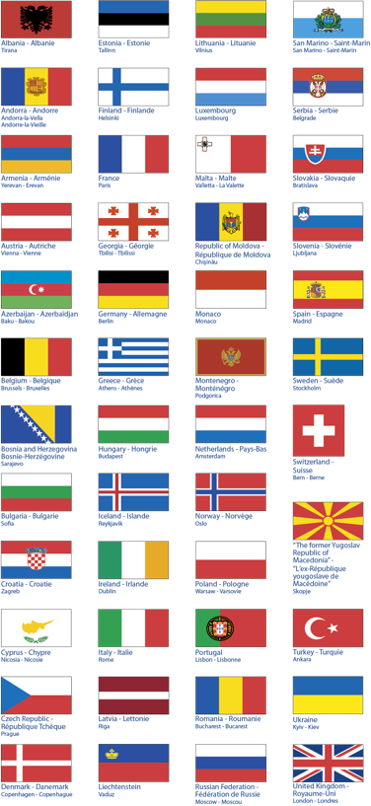
Notes:
HELP réunit des ecoles de la magistrature et des barreaux des 47 Etats membres du Conseil de l’Europe, et est assistée par un Secrétariat. Des Observateurs peuvent être admis à ses travaux. L’Union européenne participe également à ses activités.

Slide 71
HELP’s goal
HELP judges, prosecutors and lawyers to apply European human rights standards in their daily work, mainly by training
Notes:
ECHR + ESC + CoE legislation + EU law for EU
+ EU Charter and EU law for EU countries

Slide 72
HELP key components
1) HELP Network
2) Free online courses

Slide 73
HELP courses
Admissibility criteria (ECtHR)
Notes:
FARXHT: 205
Antidiscrimination: 207
Hate crime/hate speech: 164
TOTAL:
TOTAL HELP28: 1.765 (995 + 770 Asylum)
The promotion by the Spanish School of Judiciary of the HELP course on introduction to the Convention and Strasbourg (optional so far) has led to the decision to make it compulsory for new entry judges in Spain as of 2018.
In France, the participants of the HELP course on data protection and privacy rights (DPPR) set up an organisation that collectively submitted a proposal to improve the new DPPR law to the French data protection authority.
The Lithuanian labour inspectorate received a request from the Norway labour inspectorate to cooperate in joint (cross-border) inspections both in Lithuania and in Norway for “fake posting” and “social dumping”. He said, “The knowledge that I gained during the HELP course helped me to successfully perform in joint inspections, achieve results and, hopefully, accelerate future cooperation of the Lithuanian and Norwegian labour inspectorates.”

Slide 74

Course ‘Data Protection and privacy rights’
Click on the picture for
video presentation!

Slide 75

Data Protection and privacy rights
  Basic knowledge:
  Legal framework
  Role of European institutions
  Concepts, principles and rules
  Problematic Areas:
  health
  media
  e-communications & marketing
  new technologies
  work place surveillance
  Enforcement:
  Remedies and enforcement (administrative, criminal and civil law)
  Transborder data flows

Slide 76
Course ‘Data Protection and privacy rights’
  OBJECTIVES
  Knowledge
    European legal system of protection
    Case law (ECtHR, CJEU)
  Skills & attitudes: Refer to relevant legal framework in your daily work as legal professional
Notes:
Skills & attitudes: Refer to relevant legal framework in your daily work as legal professional

Slide 77
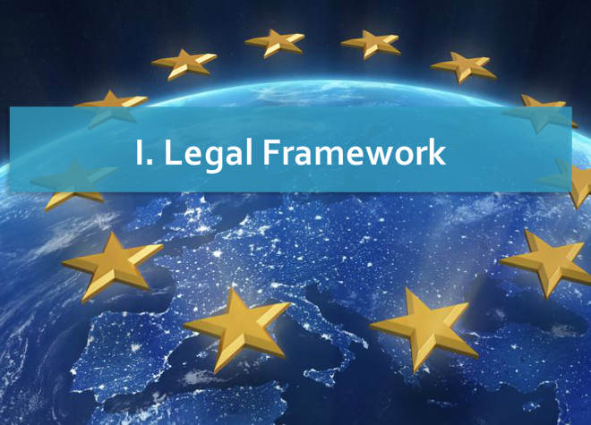
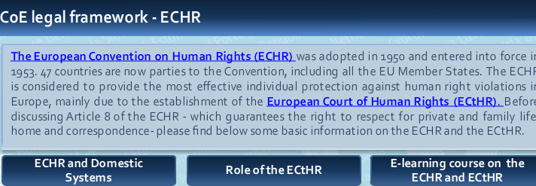
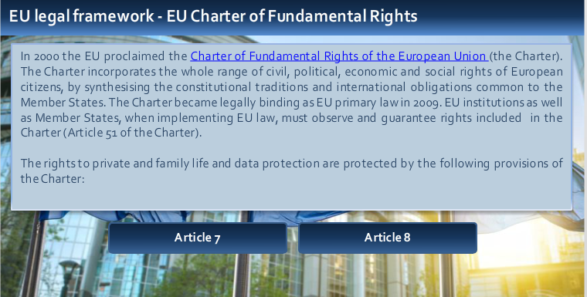
Course ‘Data Protection and privacy rights’

Slide 78
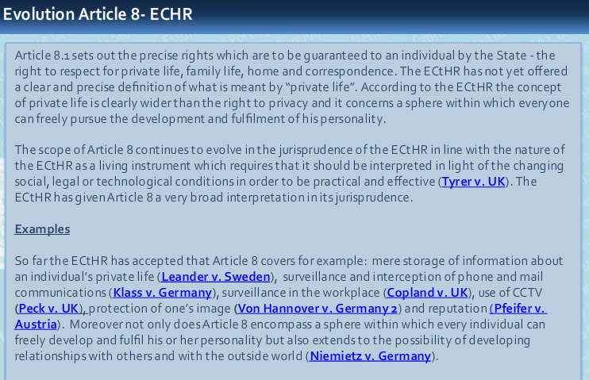


Course ‘DPPR - case law examples’

Slide 79



Course ‘‘DPPR – case law example’’

Slide 80





Course ‘DPPR – video examples’
Sophie Kwasny, Council of Europe
Click on the picture to hear ECtHR Estonian Judge
Notes:
In this video from May 2016, Giovanni Buttarelli, the European Data Protection Supervisor explains the essence of the EU Data Protection Reform

Slide 81




Course ‘‘DPPR – Module example’’

Slide 82


Course ‘‘DPPR – score results’’

Slide 83
Course ‘‘Data Protection and Privacy Rights’’
Online course duration is 18-20 hrs. More if reviewing links
Moderated course by national tutor: 4 hrs per 2 weeks over 3-4 months

Slide 84
Course ‘International Cooperation on Criminal Matters’
Click on the picture for
video presentation!

Slide 85
HELP course on ‘International Cooperation on Criminal Matters’
Content:
Principles of int’l judicial cooperation in criminal matters
Legal frameworks and legal instruments for cooperation
Applied under a general consideration for human rights
Jointly developed bet. HELP and the Council of Europe’s Committee of Experts on the Operation of European Conventions on Co-operation in Criminal Matters (PC-OC), with assistance of the European Judicial Training Network (EJTN)
Funded under the EU/CoE “Horizontal Facility for Western Balkans and Turkey”
Notes:
The HELP online course on International Cooperation in Criminal Matters explores fundamental principles of international judicial cooperation in criminal matters and a range of legal frameworks and legal instruments for cooperation- applied under a general consideration for human rights issues.
In a rapidly changing world under the challenges of globalization and new technologies; to combat transnational crimes such as organized crime, corruption and terrorism and national crimes, mechanisms and instruments of international cooperation in criminal matters are of paramount importance. Trying to provide their citizens with safety and security, it is vital for states to enhance their capacity to deal promptly and efficiently with international cooperation requests based on a range of treaties in European and International Law.
This free on-line course is primarily addressed to legal professionals (judges, prosecutors, central authorities ) working in the field of international cooperation in criminal matters but also to lawyers, academics and other persons interested in this field.
The course consists of ten substantive modules which are explored in a practical way, by using presentations, interactive screens, etc

Slide 86
HELP course on ‘International Cooperation on Criminal Matters’
Structure
1. Introduction
2. Legal Framework
3. Extradition
4. Mutual Legal Assistance
5. Transfer of Sentenced Persons
6. Supervision of Offenders, International Validity of Criminal Judgments and Transfer of Proceedings.
7. Seizure and Confiscation of Proceeds of Crime
8. International Cooperation Toolbox
9. Knowledge Check
10. Case Study
Notes:
The HELP online course on International Cooperation in Criminal Matters explores fundamental principles of international judicial cooperation in criminal matters and a range of legal frameworks and legal instruments for cooperation- applied under a general consideration for human rights issues.
In a rapidly changing world under the challenges of globalization and new technologies; to combat transnational crimes such as organized crime, corruption and terrorism and national crimes, mechanisms and instruments of international cooperation in criminal matters are of paramount importance. Trying to provide their citizens with safety and security, it is vital for states to enhance their capacity to deal promptly and efficiently with international cooperation requests based on a range of treaties in European and International Law.
This free on-line course is primarily addressed to legal professionals (judges, prosecutors, central authorities ) working in the field of international cooperation in criminal matters but also to lawyers, academics and other persons interested in this field.
The course consists of ten substantive modules which are explored in a practical way, by using presentations, interactive screens, etc.

Slide 87
Courses available
Introduction to the ECHR and the ECtHR
Admissibility criteria (ECtHR)
Asylum
Family law
Child-friendly justice and children’s rights
Anti-discrimination
Hate crime/hate speech
Community sanctions and alternative measures to detention
International co-operation in criminal matters
Business and human rights
Counterfeiting of medical products and crimes against public health
Transitional justice
Property rights
Freedom or expression
Trafficking in light of the ECHR
Pre-trial investigation in the light of ECHR
Reasoning of judgments
Fight against racism, xenophobia and homophobia
Data protection and privacy rights
Labour rights
Right to the integrity of the person (bioethics)
‘HELP in the 28’ courses

Slide 88
HELP pipeline courses for 2018
Child refugee and migrants
Procedural rights in criminal proceedings and victims’ rights
Radicalisation Prevention
Family Law
Rights of persons with disabilities
Human Rights in Sports
Fight against Drugs
EU funding
Notes:
This is to send you the list of the HELP courses, with yellow highlights those that may have topics or modules relevant for police in the context of counter-terrorist operations:
1. Introduction to the ECHR and the ECtHR
2. Admissibility criteria (ECtHR)
3. Asylum
4. Family law
5. Child-friendly justice and children’s rights
6. Anti-discrimination
7. Hate crime/hate speech
8. Community sanctions and alternative measures to detention
9. International co-operation in criminal matters
10. Business and human rights
11. Counterfeiting of medical products and crimes against public health
12. Transitional justice
13. Property rights
14. Trafficking of human beings
15. Pre-trial investigation in the light of ECHR
16. Reasoning of judgments in criminal cases
17. Fight against racism, xenophobia and homophobia*
18. Data protection and privacy rights*
19. Labour rights*
20. Right to the integrity of the person (bioethics)*

Slide 89
HELP
Good training for good judgments
Thank you very much for your attention!
HELP in Belarus: Sergey.DIKMAN@coe.int
HELP in Russia: Anastasia.SHADAROVA@coe.int
HELP - Universities: Ana.MEDARSKA-LAZOVA@coe.int
HELP Head of Unit: Eva.PASTRANA@coe.int

