Slide 1

The experience of digital company law in Estonia and a critical assessment of the recent directive on the digitalization of company law
Kai Härmand
Deputy Secretary General on Legal Policy
Ministry of Justice, Estonia

Slide 2
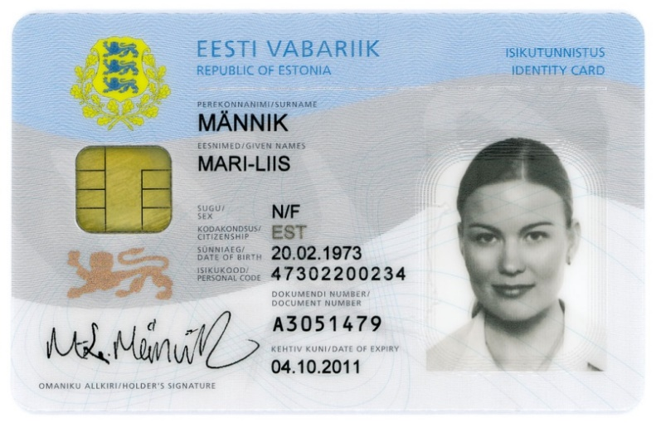
ID-card
ID card is ID + travel document. (Max. validity 5 years)
Contains:
  Visual personal information
  Personal data file
  Certificate for authentication
  (e-mail address)
  Certificate for digital signature

Slide 3
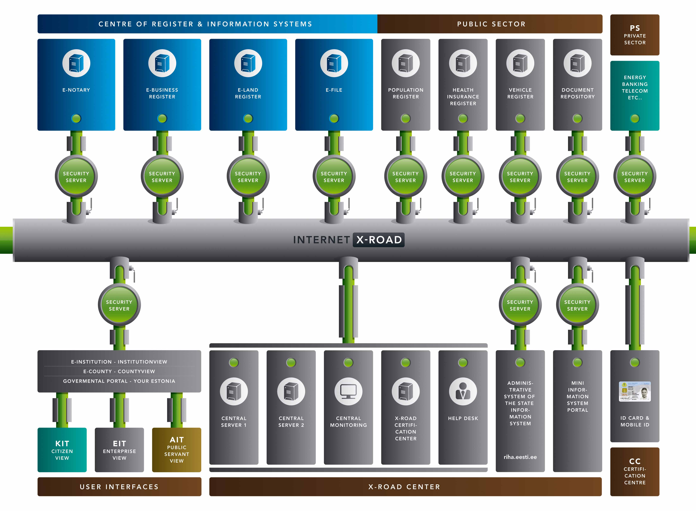

Slide 4
e-Business Register

Slide 5
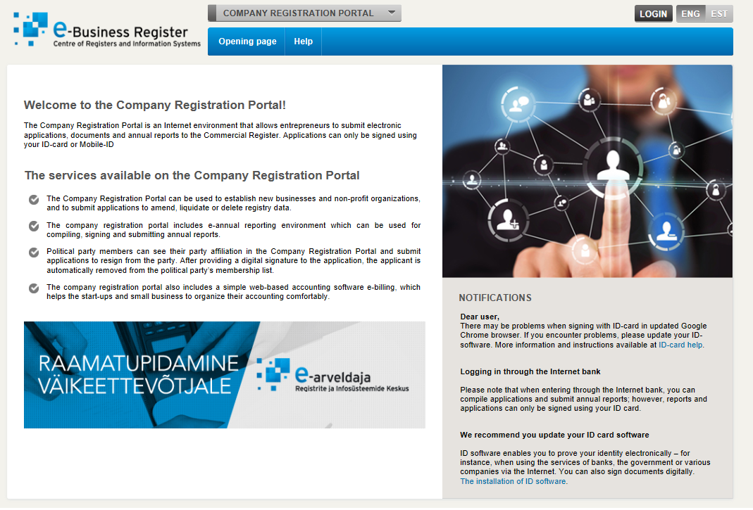

Slide 6
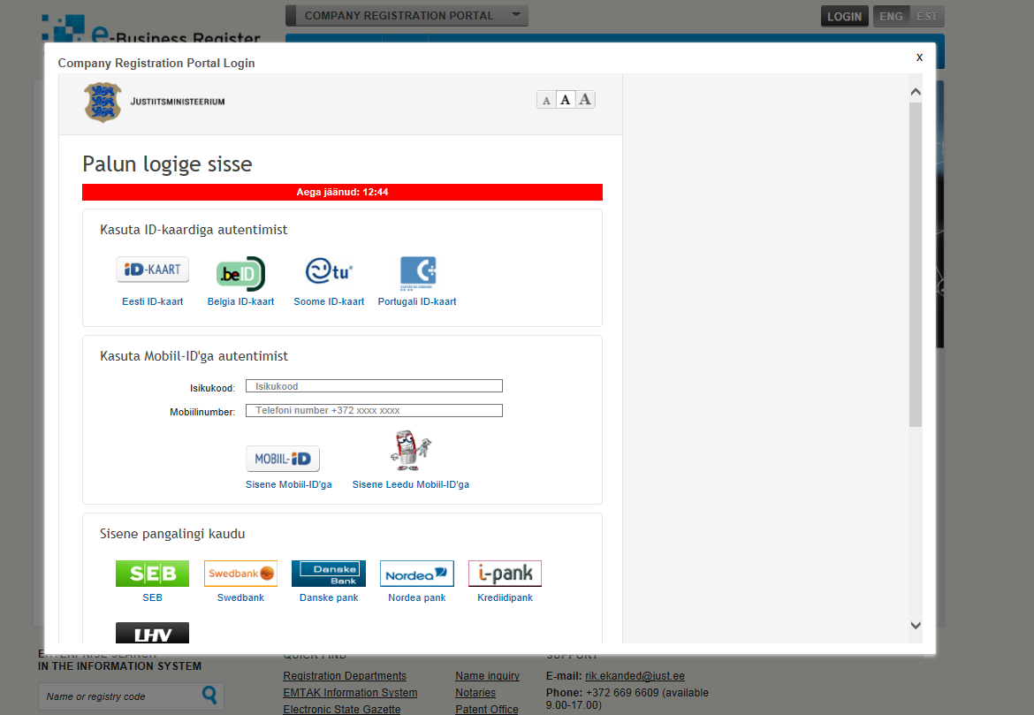

Slide 7
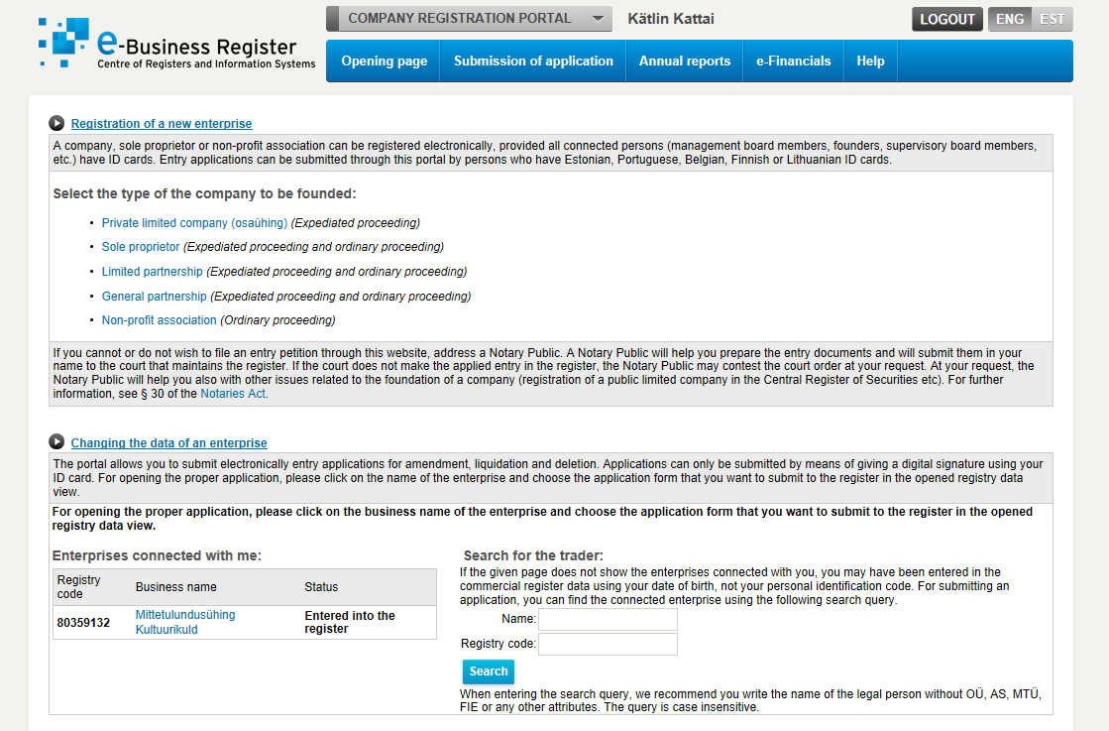

Slide 8
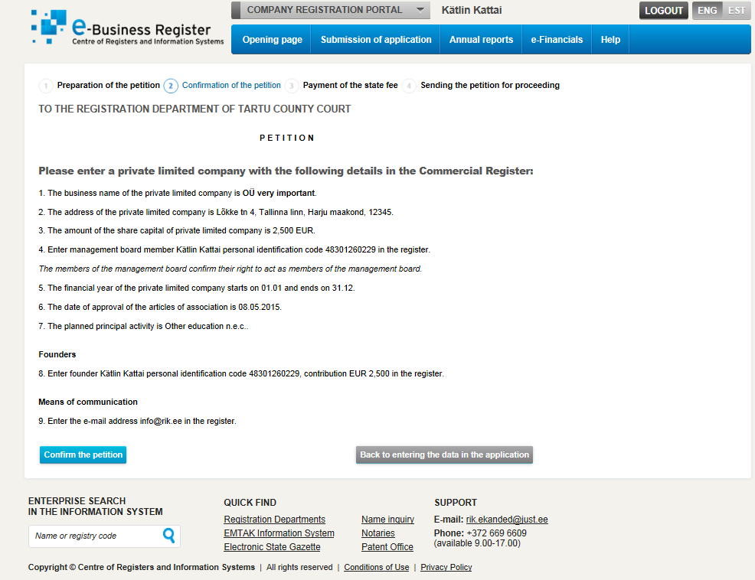

Slide 9
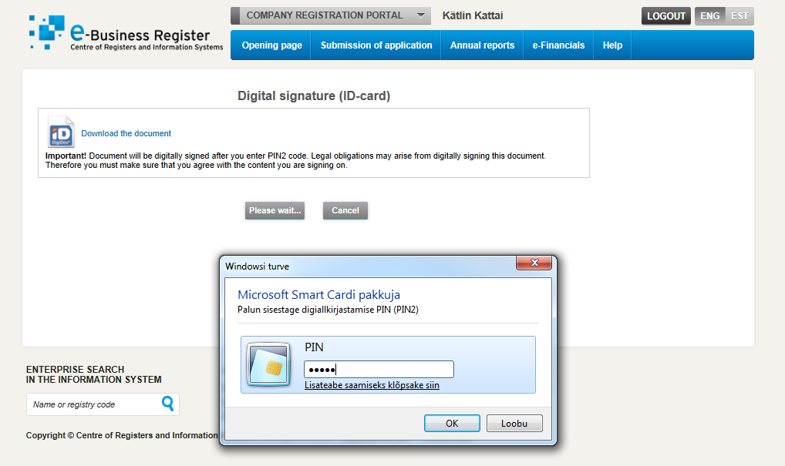

Slide 10
Challenges of digitalization directive (EU) 2019/1151
Trust cross-border electronic identification
Disqualified directors

Slide 11
Thank you!
Kai Härmand
Kai.Harmand@just.ee

