Slide 1
CCBE CONFERENCE: TRAINING OF LAWYERS, CHALLENGES AND OPPORTUNITIES WORKSHOP 1a DESIGN THINKING AND LEGAL DESIGN WIFI L42 Pass: allfornet

Slide 2
WORKSHOP 1a
Bénédicte Bury, CCBE expert, Conseil national des barreaux
Eléonore Zahlen, Avocats Conseils d’Entreprises
Fabrice Mauleon, Expert in Business Transformation, Professor

Slide 3
Training of lawyers: challenges and opportunies
Workshop Design thinking and legal design
An example of legal design: visual law
Éléonore ZAHLEN
Lawyer, Paris

Slide 4
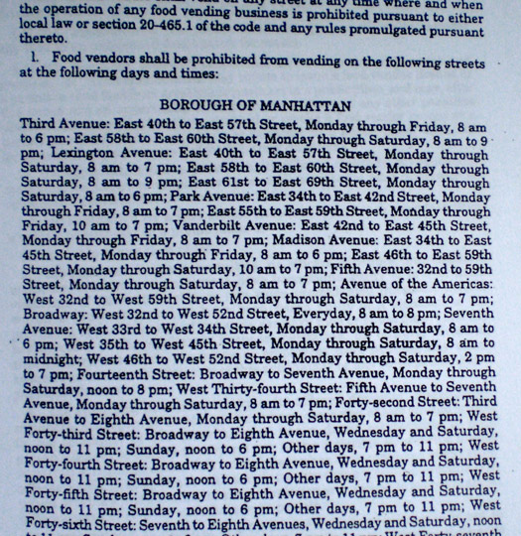
New York regulation on Food vendors

Slide 5
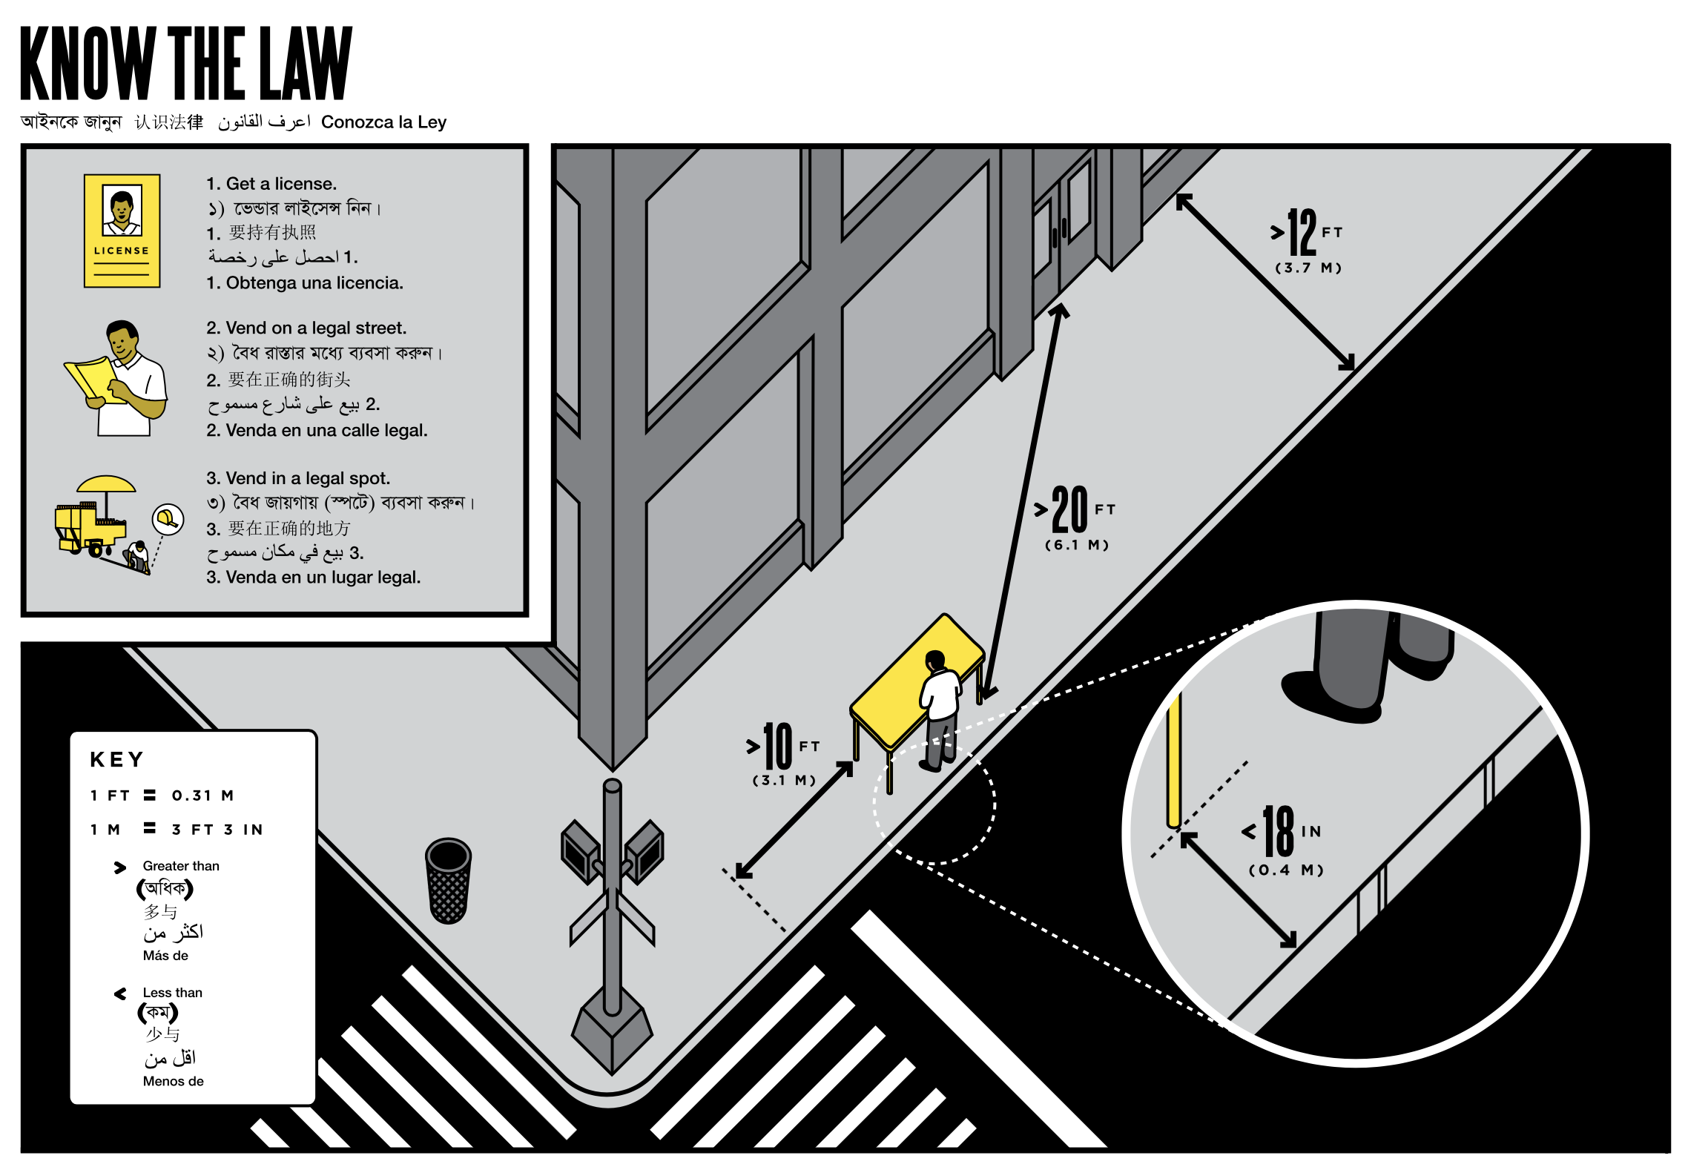
Vendor power: a guide created by the Center for Urban Pedagogy. Designer Candy Chang

Slide 6
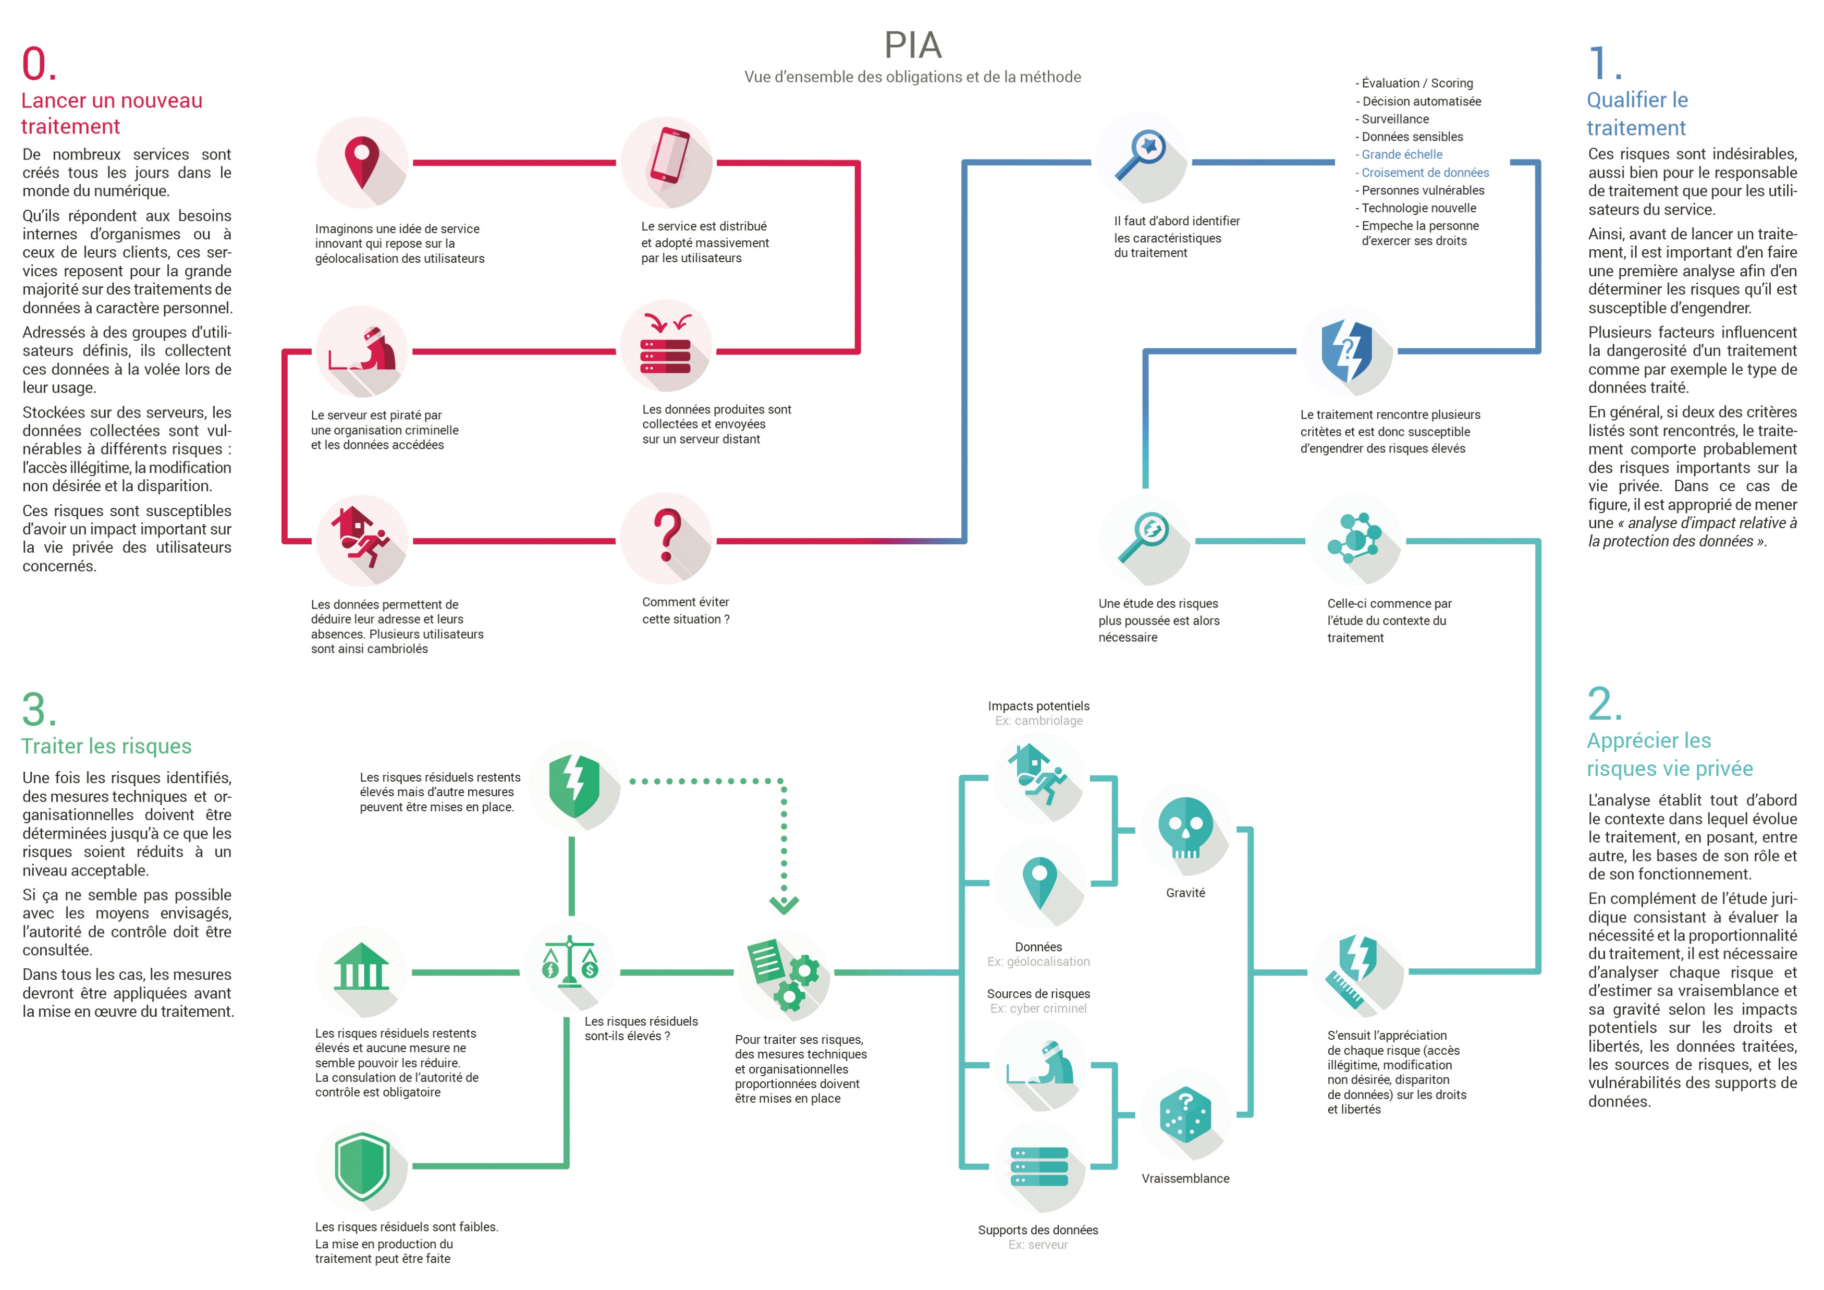
Bird&Bird Guide to the General Data Protection regulation
https://www.twobirds.com/~/media/pdfs/gdpr-pdfs/bird--bird--guide-to-the-general-data-protection-regulation.pdf?la=en
CNIL
https://www.cnil.fr/fr/ce-quil-faut-savoir-sur-lanalyse-dimpact-relative-la-protection-des-donnees-dpia

Slide 7
Why?

Slide 8
Why?

Slide 9
Why?

Slide 10
Why?

Slide 11
When?

Slide 12
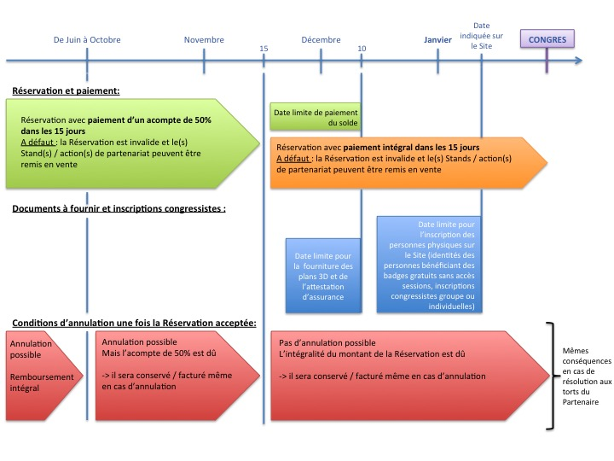
→ Counsel (legal opinions, contracts, etc)
When?
(Extract of general terms and conditions for booking stands at a congress)

Slide 13
→ Counsel (legal opinions, contracts, etc)
When?
(Extract of general terms and conditions for booking stands at a congress)
→ Litigation

Slide 14
→ Counsel (legal opinions, contracts, etc)
When?
(Extract of general terms and conditions for booking stands at a congress)
→ Litigation
→ In-house work

Slide 15
How?

Slide 16
Liability
→ use should be adapted
How?

Slide 17
Liability
→ use should be adapted
How?
Make it a cabinet/firm project

Slide 18
Liability
→ use should be adapted
How?
Make it a cabinet/firm project
Need for training!!

Slide 19
Thank you for your attention
Eléonore ZAHLEN
Lawyer
12, rue Lagrange
75005 Paris
+33 (6) 77 13 55 02 eleonore@zahlen-avocat.com
@EleonoreZahlen

