Slide 1
THE PROPOSAL OF THE CHAMBER OF ADVOCATES OF THE REPUBLIC OF ARMENIA
EXTENDED COOPERATION BETWEEN THE ADVOCATES OF COE MEMBER STATES
Yerevan, 09 March 2018

Slide 2
Very often an advocate from one state needs legal cooperation in the territory of another state, while representing the interests of his client.
It can refer to matters of property registration, transaction conclusion, litigation, arbitrage, investment in other state and etc..
As a rule, the advocates try to find advocate-colleagues via personal contacts, networks of advocates’ offices, internet and via the chamber of advocates.

Slide 3
Development of a platform of cooperation between the advocates of CCBE members and observer members of advocates is suggested.
The mentioned platform must allow the advocate to independently choose and contact an advocate from another state via the website of their own chamber of advocates.

Slide 4
The platform is created as a separate section within the website.
The list of advocates is created in English.
Each section allows to download the list of the advocates of the particular country, e.g. Advocates of the Republic of Armenia, Advocates of Moldova.
The Chamber of Advocates of each state assigns a responsible person, who can be contacted by advocate of any state if the advocate, with whom he cooperates and who is included in the list of cooperation, breaks the terms of cooperation.

Slide 6
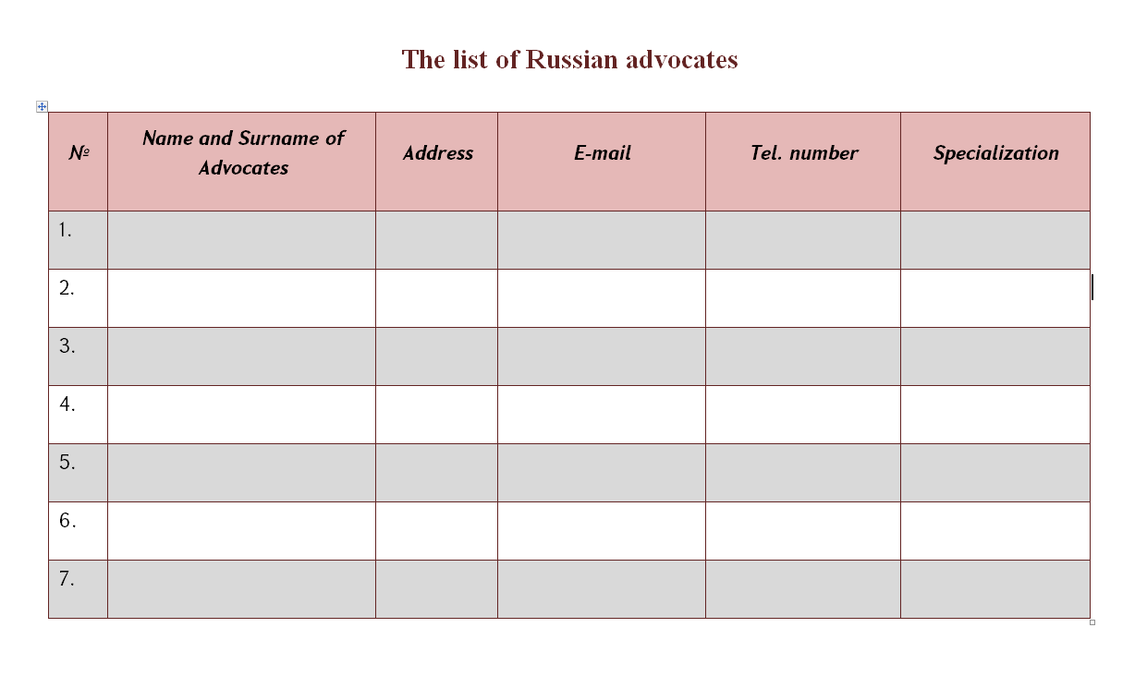

Slide 7
Terms of cooperation
CCBE member and observer member, together or separately, can set rules of cooperation and suggest their advocates enrollment in the list.
In order to be included in the list the advocate must present their consent about the rules of cooperation.
The list is updated once in a year.
Every year, for exemple in April, the chambers of advocates exchange with the lists of advocates approved for that year and publish the lists in their websites.

Slide 8
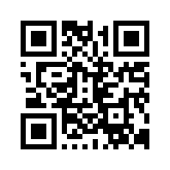
Thank YOU for your
attention
CHAMBER OF ADVOCATES
OF THE REPUBLIC OF ARMENIA
info@advocates.am

